Slide 1

FLIGHT PRICE PREDICTION

Slide 2
AGENDA
Introduction​
Problem Statement
Business Goal
Technical Requirement
Exploratory Data Analysis (EDA)
Data Cleaning
Visualization
Data Pre-Processing
Build Model
Save Best Model
Summary​

Slide 3
Introduction
Anyone who has booked a flight ticket knows how unexpectedly the prices vary. The cheapest available ticket on a given flight gets more and less expensive over time.
This usually happens as an attempt to maximize revenue based on –
1. Time of purchase patterns (making sure last-minute purchases are expensive)
2. Keeping the flight as full as they want it (raising prices on a flight which is filling up in order to reduce sales and hold back inventory for those expensive last-minute expensive purchases).

Slide 4
Business Goal
So, have to work on a project where have to collect data of flight fares with other features and work to make a model to predict fares of flights.
This project contains three phases:
Data Collection Phase,
Data Analysis and
Model Building Phase.

Slide 5
Technical Requirements
Data Collection Phase :
Scrapped 1614 rows of data from website: Yatra.com and Makemytrip.com
The number of columns are:
Airline_Name,
Date_of_Journey,
Source,
Destination,
Departure_Time,
Arrival_Time,
Duration,
Total_Stops and
Price
2. Data Analysis:
After cleaning the data, you have to do some analysis on the data.
Do airfares change frequently?
Do they move in small increments or in large jumps?
Do they tend to go up or down over time?
What is the best time to buy so that the consumer can save the most by taking the least risk?
Does price increase as we get near to departure date?
Is Indigo cheaper than Jet Airways?
Are morning flights expensive?
3. Model Building Phase:
Data Cleaning
Exploratory Data Analysis
Data Pre-processing
Model Building
Model Evaluation
Selecting the best model

Slide 6
Exploratory Data Analysis (EDA)
Checked Total Numbers of Rows and Column
Checked All Column Name
Checked Data Type of All Data
Checked for Null Values
Checked for special character present in dataset or not
Checked total number of unique value
Dropped irrelevant Features
Replaced duplicate values, special characters and irrelevant data
Checked Information about Data
Checked all features through visualization.

Slide 7
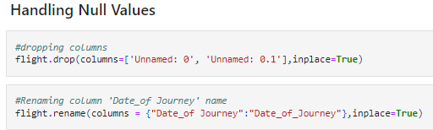
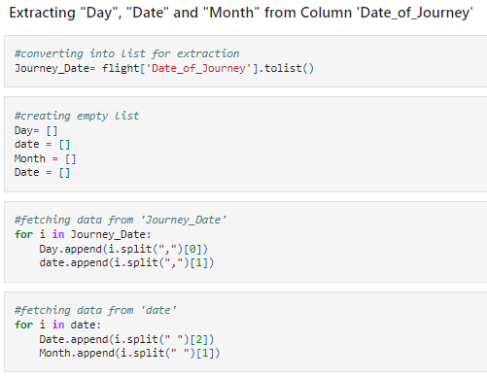
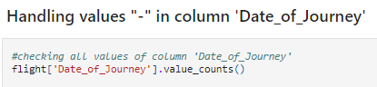
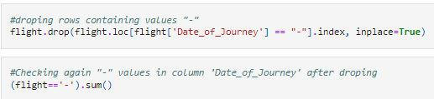
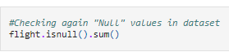
Data Cleaning

Slide 8
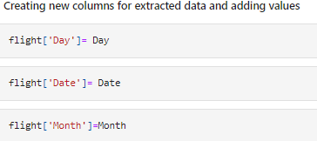
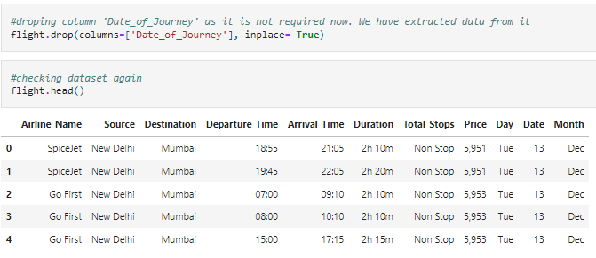

Slide 9
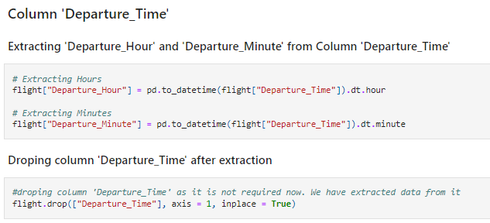
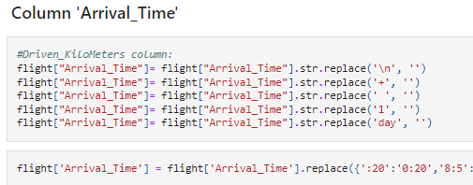
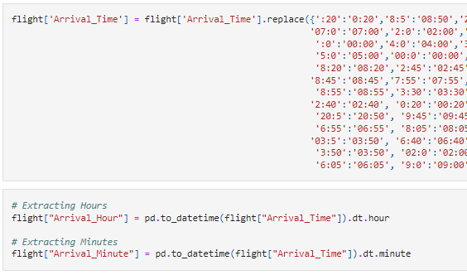
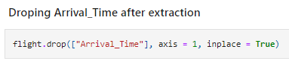

Slide 10
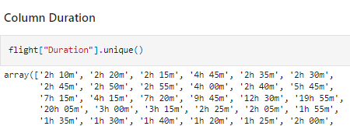
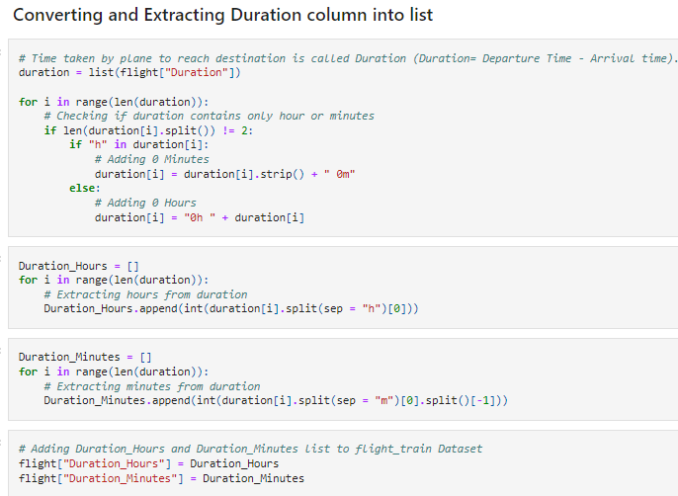
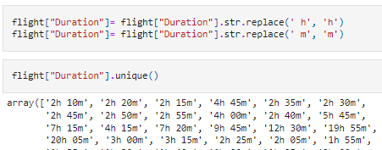
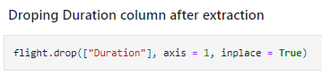

Slide 11
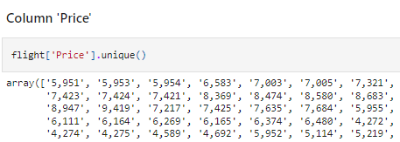
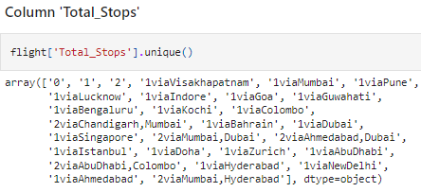
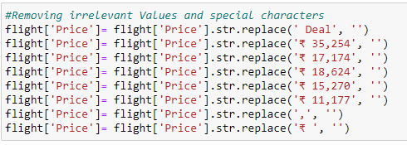
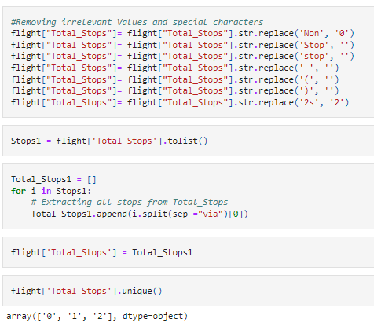

Slide 12
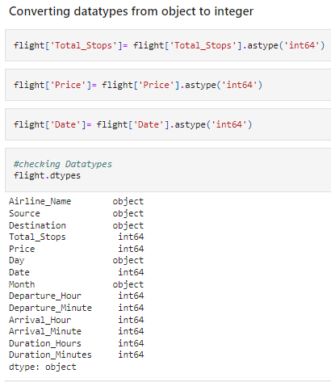
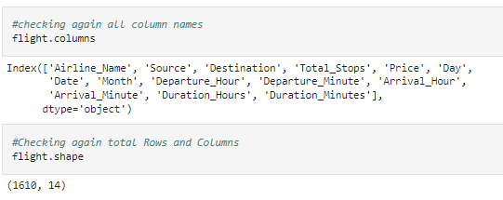

Slide 13
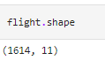
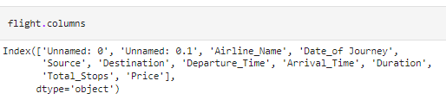
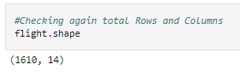
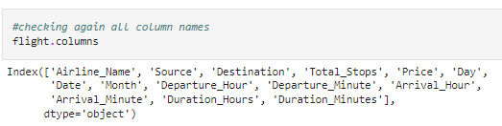
Data Description
The dataset contains 1614 records (rows) and 11 features (columns). And after removal of irrelevant data and column, also after extraction of hidden features, we remains with 1610 records (rows) and 14 features (columns).

Slide 14
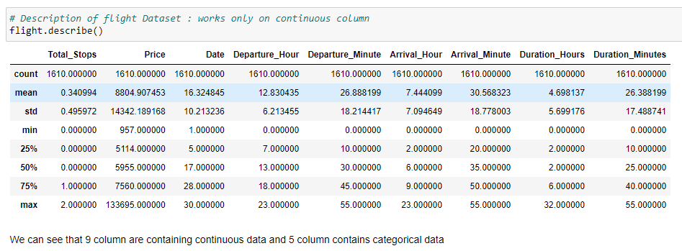
DataSet Description

Slide 15
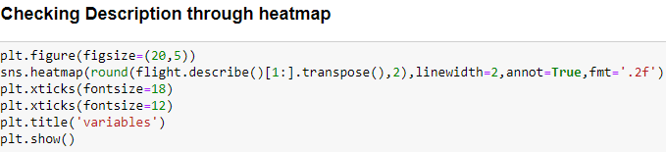
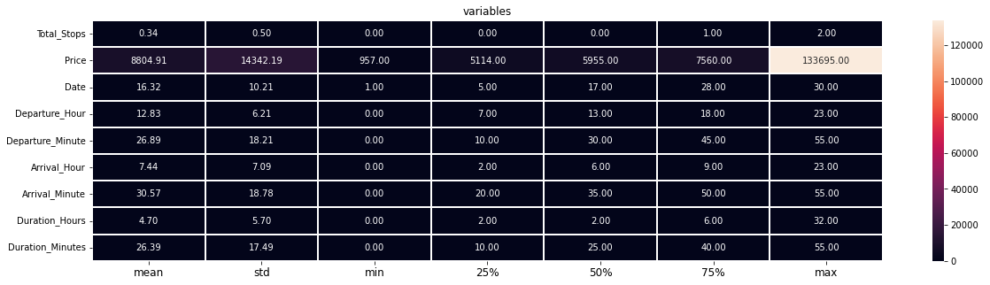
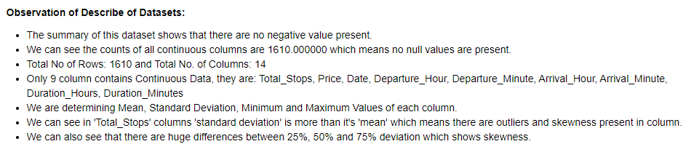

Slide 16
Data Visualization
Univariate Analysis Using Countplot and Histplot 2. Bivariate Analysis (for comparison between features and target) Using Barplot 3. Multivariate Analysis Using Pairplot (comparison between all continuous features and target)

Slide 17
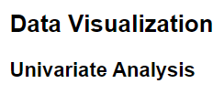
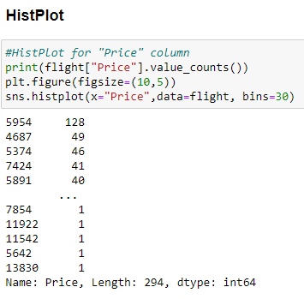
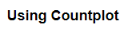
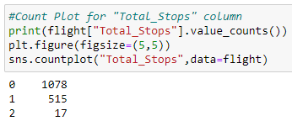
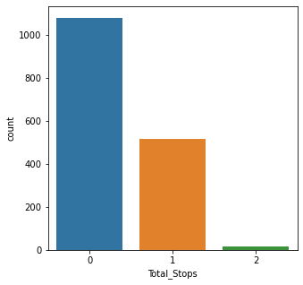
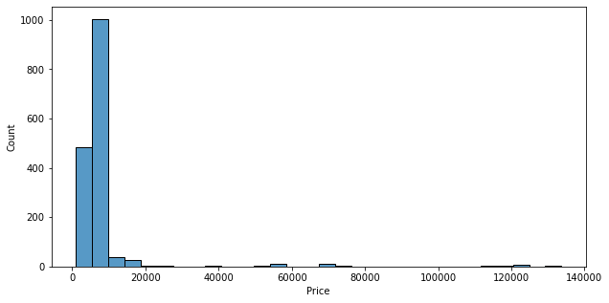

Slide 18
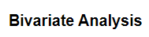
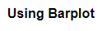
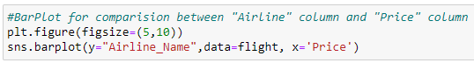
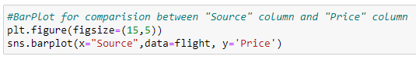
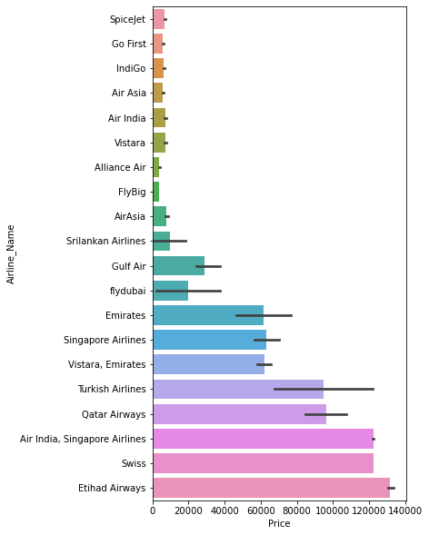
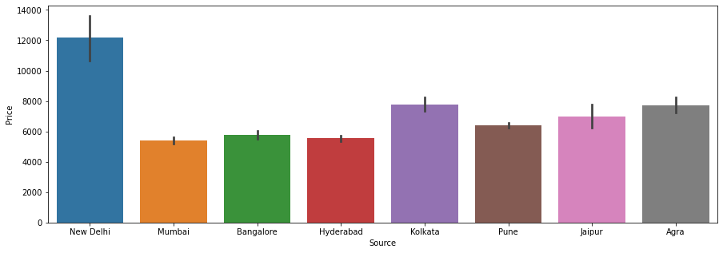

Slide 19
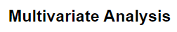
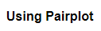
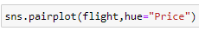
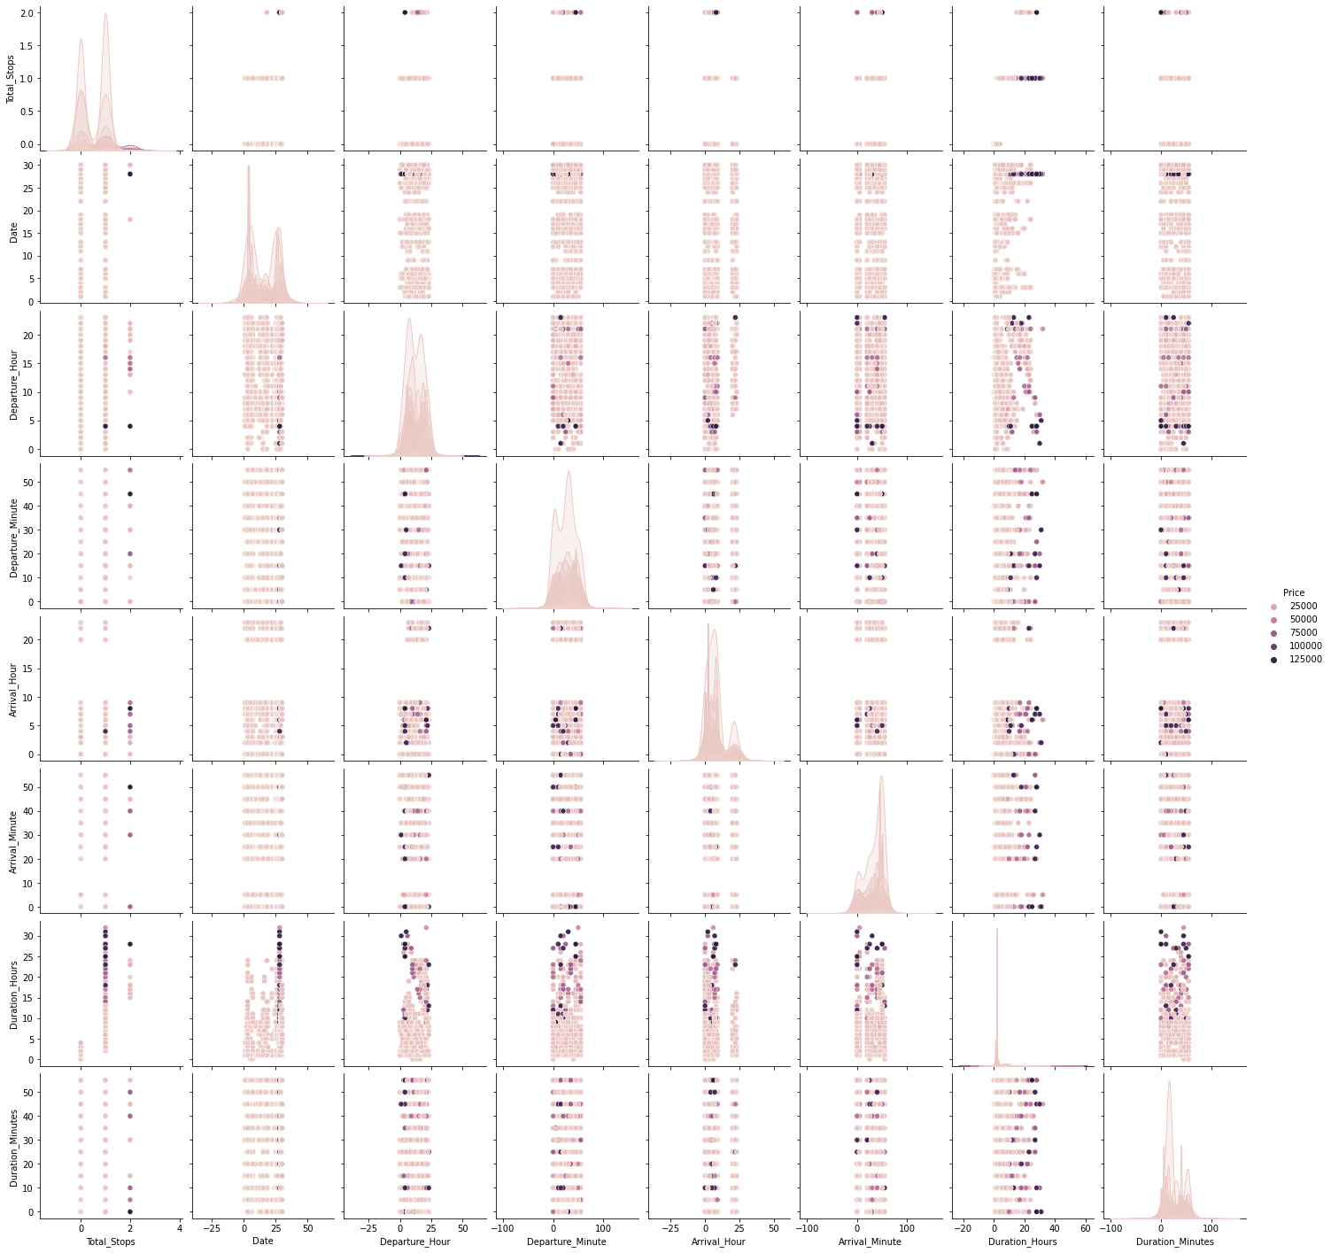

Slide 20
Analysis of Data after Cleaning the Data
Yes, airfares change frequently, in a minute it get changes.
They move in small increments or in large jumps.
Yes they tend to go up or down over time.
Buy afternoon flight ticket with having No stop and 1 month earlier if possible so that we can save the most by taking the least risk.
Flight price increases as we get near to departure date
No Indigo is not cheaper than Jet Airways. But it is purchased most. There is a little difference in the fare of both flights.
Morning flights are expensive mostly early morning that is 4AM flights.

Slide 21
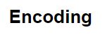
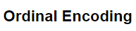
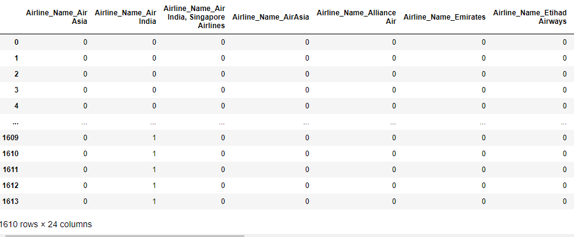

Slide 22
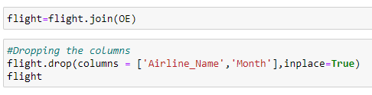
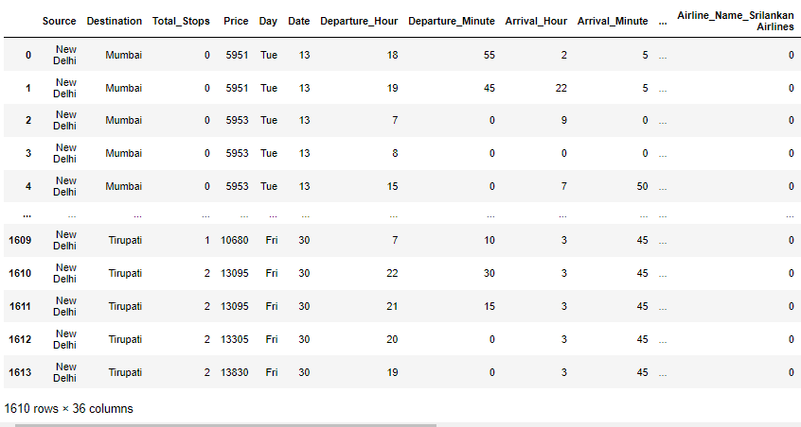

Slide 23



Slide 24



Slide 25

Checking Correlation
Correlation is checked for relation between the dependent and independent variables. Also Checked through HeatMap and BarPlot (Visualization)

Slide 26



Slide 27



Slide 28




Slide 29



Slide 30

Checking Outliers

Slide 31


Slide 32


Slide 33

Removing Outliers
Outliers are removed only from continuous features and not from target
Checking two methods and compare between them which is give less percentage loss and then using that method for further process. Zscore method using Scipy IQR (Inter Quantile Range) method

Slide 34



Comparing shape of old and new DataFrame after outliers removal
Comparing shape of old and new DataFrame after outliers removal

Slide 35


Comparing Data Loss Using both Method after Outlier Removal

Slide 36



Checking Skewness

Slide 37


Slide 38

Removing skewness
Using yeo-johnson method

Slide 39


checking skewness after removal

Slide 40


checking skewness after removal Through Visualization

Slide 41






Slide 42


Slide 43


Slide 44


Slide 45



Slide 46





Slide 47



Slide 48


Slide 49


Slide 50


Slide 51


Slide 52


Slide 53


Slide 54



Slide 55


Slide 56



Slide 57


Final Procedure: 1. Saving the model 2. Comparing Actual and Prediction

Slide 58



Slide 59



3. Saving the model in CSV format

Slide 60
SUMMARY
Here we have made a flight price prediction model as an attempt to maximize revenue based on –
Time of purchase patterns (making sure last-minute purchases are expensive)
Keeping the flight as full as they want it (raising prices on a flight which is filling up in order to reduce sales and hold back inventory for those expensive last-minute expensive purchases)
For flight price prediction model, we have done prediction on basis of Data using EDA, Data Cleaning, Data Visualization, Data Pre-processing, Checked Correlation, Removed irrelevant values, Extracted hidden features, Removed Outliers, Removed Skewness and at last train our data by splitting our data through train-test split process.
Built our model using 5 models and finally selected best model which was giving best accuracy that is Gradient Boosting Regressor. Then tunned our model through Hyper Tunning using GridSearchCV. And at last compared our predicted and Actual Price of Flight. Thus our project is completed.

Slide 61
THANK YOU
Prepared by: Archana Kumari
SME Name: Shwetank Mishra

